Slide 1
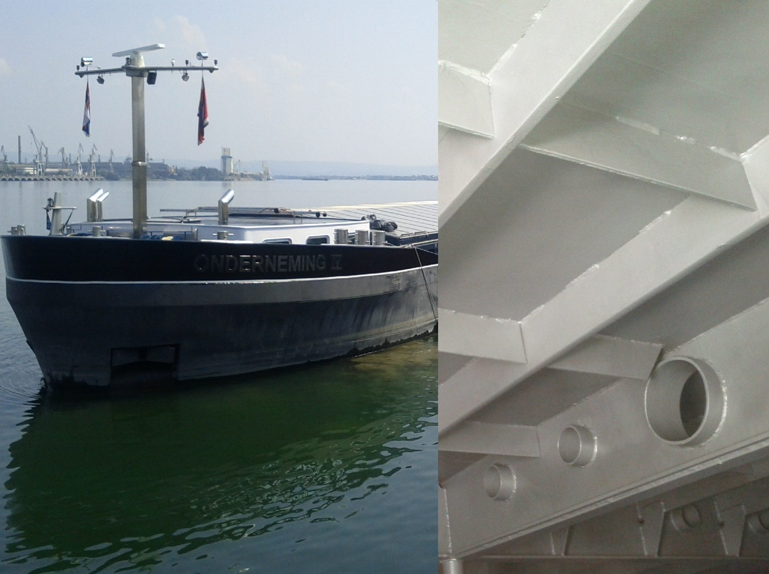


STUDY CASES
The booklet presents specific applications of the welding processes, gathered from industrial domains
BEGIN

Slide 2
STUDY CASES
INDEX
01
SHIPBUILDING
Board (2)
Bottom (2)
Cabine (2)
Hull (2)
02
RAILWAY
Lateral longeron
Pivot girder
Body structure
03
AUTOMOTIVE
Body structure
04
PIPELINE
BRUA gas pipeline (2)
End piece with flange
05
PRESSURE VESSEL
Shell ring
Visiting window (Nozzle) to shell
Membrane wall
06
CIVIL CONSTRUCTION
Double node of parallel elements with stiffener
Stiffening of node with gusset
Intersection of I beams
Node of two elements
Beams node
Tubes node

Slide 3
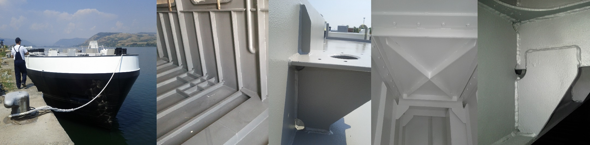
UNIT 1. SHIPBUILDING
SHIPBUILDING
Shipbuilding is industry which deals very close with the welding processes. More than 90% of the joints are welded. Arc welding is the main used group of welding processes. GMAW, SAW and MMA processes are involved in the fabrication of each type of ship (river ships, short sea ships, maritime ships, etc.).
The study cases were considered from river ships and they are related to the structure of a tank or barge boards, bottoms and cabins.
STUDY CASE
INDUSTRY

Slide 4
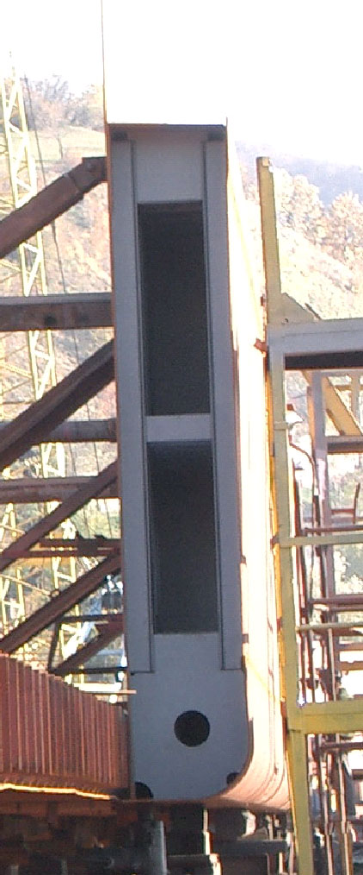
UNIT 1. SHIPBUILDING
BOARD OF BARGE - DESCRIPTION
The board of a barge is component of a ship having fillet and butt joints. The fillet welds are used to create the shape of the board and the stiffening of the board. The butt welds are dedicated to create large surface as the walls membranes.
According to the figure, all the welds (the bulb stiffeners with the interior/exterior board, the bulb stiffeners with the gussets, the superior gusset with the deck, the inferior gusset with the bilge, the transverse stiffener with the bulb stiffeners, the interior wall with the bilge) from the section are fillet weld. The joint between the bilge and the exterior board is butt weld. Due to that it were considered for analysis:
Weld of board (interior or exterior) to bulb stiffeners
Weld of exterior board to bilge.
Materials: A 32
Deck
Gusset
Interior board
Exterior board
Transverse
Bulb stiffeners
Gusset
Bilge
Weld 1
(Board to bulb)
Weld 2
(Board to bilge)
Grade | Chemical composition, %
 | C≤ | Si≤ | Mn | P≤ | S≤ | Cr | Ni | Al
A32 | 0.18 | 0.5 | 0.9- 1.60 | 0.040 | 0.040 | 0.20 | 0.20-0.40 | 0.020- 0.35
STUDY CASE
INDUSTRY

Slide 5
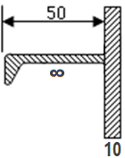
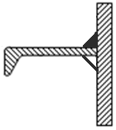
UNIT 1. SHIPBUILDING
BOARD OF BARGE – WPS WELD 1 (interior or exterior board to the bulb stiffeners)
Welding Procedure Number | 1
Welding Procedure Qualification Record (WPQR) |  | Revision: | 0
Manufacturer: | Shipyard Orsova s.a. | Method Of Preparation and Cleaning: | Cutting in dimension, cleaning impurities and grease, brushing base paint, remove slag after welding, remove spatter after welding
Location: | Workshop, Orsova | Parent Metal Specification: | A32 / A32
Welding Process: | 136 | Parent Metal Thickness | Plates: 8 to 10 mm
Joint Type: | Fillet weld | Welding Position: | PF (vertical)
Joint Design |  | Welding Sequences
Fig. 1 |  | Fig. 2
Fig. 1
Run | Process | Size of wire mm | Current A | Voltage V | Type of current/ Polarity | Wire feed speed m/min | Travel speed cm/min | Heat Input J/cm
1 | 136 | 1.2 | 170-180 | 25-26 | DC+ | 8.0-8.5 | 17-18 | 15600
Welding Consumables: Type, Designation Diameter, mm: | EN 758: T 46 2 P C 1 H AWS A5.20: E71T-1 H4 W.Nr.: 1.4430 1.2 | Technique: Weaving: max 2 mm width Inclination of the wire: 90º, 20º (pull)
Gas / Flux: Gas type Gas Flow Rate | EN ISO 14175: 100%CO₂ 12 - 14 l/min | Post Weld Heat Treatment: -
Details of Back Gouging/Backing: | NO
Fig. 2
STUDY CASE
4

Slide 6
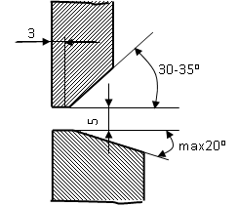
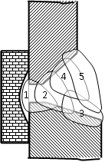
UNIT 1. SHIPBUILDING
BOARD OF BARGE – WPS WELD 2 (exterior board to the bilge)
Welding Procedure Number | 2
Welding Procedure Qualification Record (WPQR) |  | Revision: | 0
Manufacturer: | Shipyard Orsova s.a. | Method Of Preparation and Cleaning: | Cutting in dimension, cleaning impurities and grease, brushing base paint, remove slag after welding, remove spatter after welding
Location: | Workshop, Orsova | Parent Metal Specification: | A32 / A32
Welding Process: | 136 | Parent Metal Thickness | Plates: 9 to 12 mm
Joint Type: | Butt weld | Welding Position: | PC (horizontal on vertical wall)
Joint Design |  | Welding Sequences
Fig. 1 |  | Fig. 2
Run | Process | Size of wire mm | Current A | Voltage V | Type of current/ Polarity | Wire feed speed m/min | Travel speed cm/min | Heat Input J/cm
1 | 136 | 1.2 | 170 ± 5 | 26 ± 1 | DC+ | 8.0-8.5 | 17 ± 1 | 15600
2 | 136 | 1.2 | 180 ± 5 | 26 ± 1 | DC+ | 8.0-8.5 | 48 ± 1 | 5900
3 | 136 | 1.2 | 190 ± 5 | 26 ± 1 | DC+ | 8.0-8.5 | 53 ± 1 | 5600
4 | 136 | 1.2 | 200 ± 5 | 26 ± 1 | DC+ | 8.0-8.5 | 36 ± 1 | 8700
5 | 136 | 1.2 | 200 ± 5 | 26 ± 1 | DC+ | 8.0-8.5 | 34 ± 1 | 9200
Fig. 1
Welding Consumables: Type, Designation Diameter, mm: | EN 758: T 46 2 P C 1 H AWS A5.20: E71T-1 H4 W.Nr.: 1.4430 1.2 | Technique: Weaving: max 2 mm width at pass 1, max 4 mm width at pass 2 and max 6 mm width at passes 3-5 Inclination of the wire: 90º, 20º (pull)
Gas / Flux: Gas type Gas Flow Rate | EN ISO 14175: 100%CO₂ 12 - 14 l/min | Post Weld Heat Treatment: - Interpass temperature: max 200ºC
Details of Back Gouging/Backing: | NO
Fig. 2
STUDY CASE
4

Slide 7
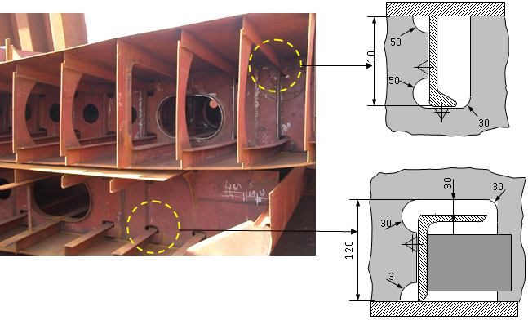
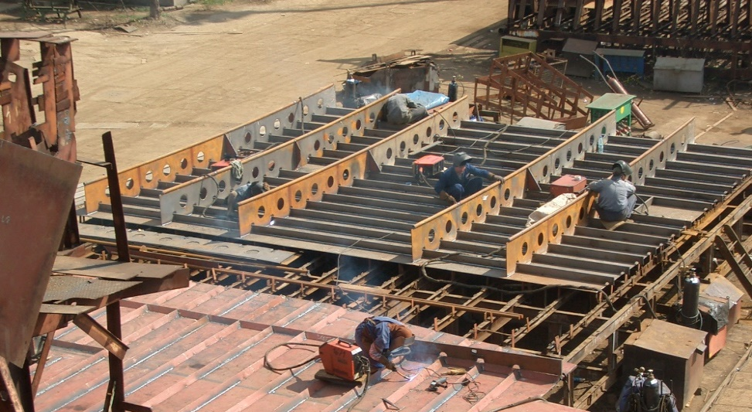
UNIT 1. SHIPBUILDING
BOTTOM OF SHIP - DESCRIPTION
The bottom of a ship is component of a ship having fillet joints to create the shapes and butt joints to prolonge the interior deck and the exterior shell (membrane). According to the figure, all the welds (the bulb stiffeners with the varangues and with the exterior bottom shell) from the section are fillet weld. Due to that it were considered for analysis:
Weld of bottom plate to bulb stiffeners
Weld of varangues to bulb stiffeners.
Materials: A 32
Weld 1 (Bulb to varangue)
Weld 2 (Bulb to bottom)
Gusset
Grade | Chemical composition, %
 | C≤ | Si≤ | Mn | P≤ | S≤ | Cr | Ni | Al
A32 | 0.18 | 0.5 | 0.9- 1.60 | 0.040 | 0.040 | 0.20 | 0.20-0.40 | 0.020- 0.35
STUDY CASE
INDUSTRY

Slide 8
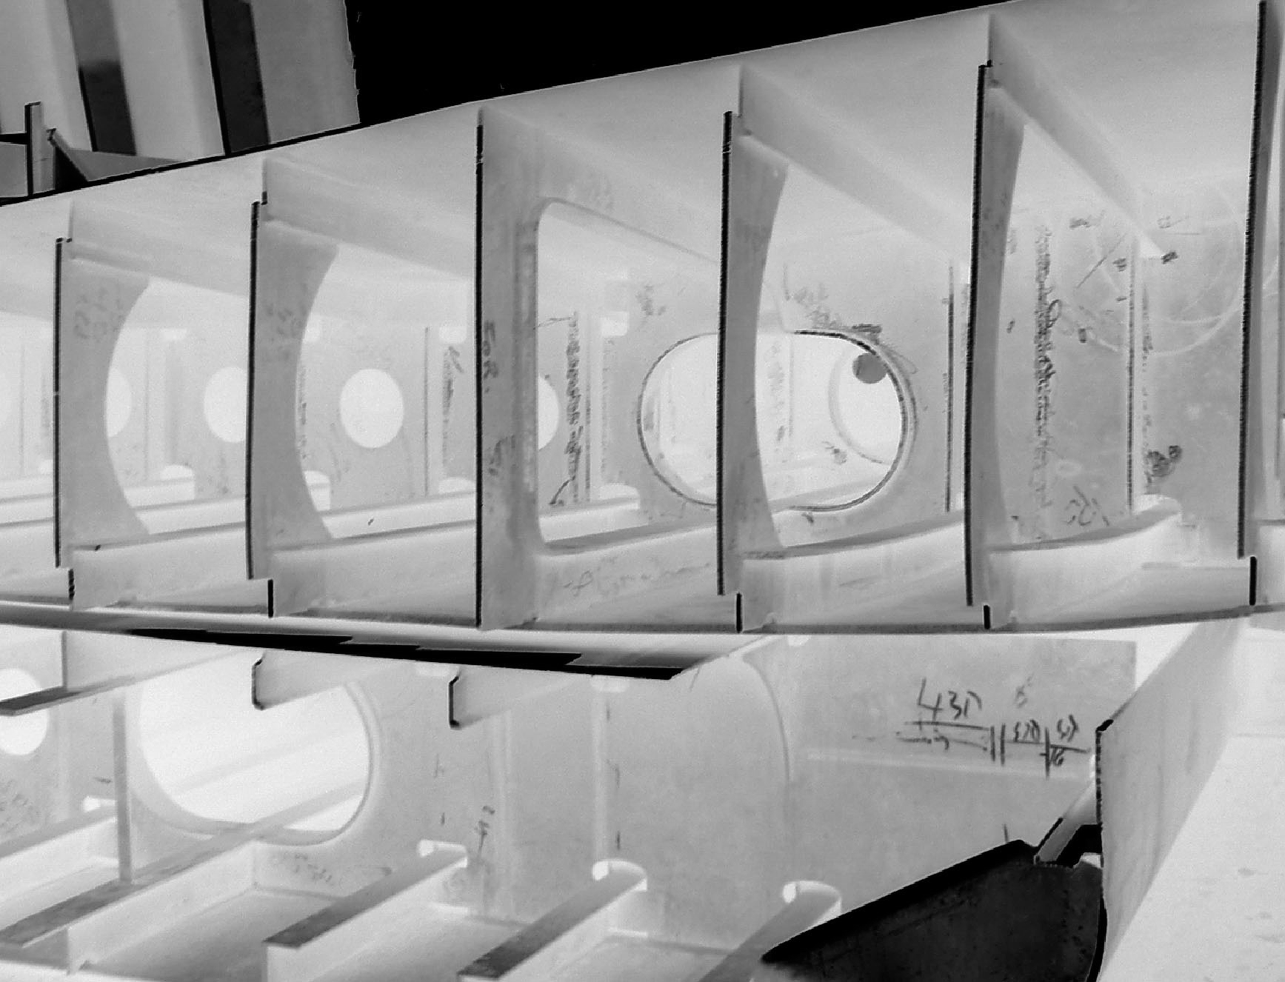
UNIT 1. SHIPBUILDING
BOARD OF BARGE – WPS WELD 1 (interior or exterior board to the bulb stiffeners)
Welding Procedure Number | 3
Welding Procedure Qualification Record (WPQR) |  | Revision: | 0
Manufacturer: | Shipyard Kladovo | Method Of Preparation and Cleaning: | Cutting in dimension, cleaning impurities and grease, brushing base paint, remove slag after welding, remove spatter after welding; stainless steel tools to be used
Location: | Workshop, Kladovo | Parent Metal Specification: | A32 / A32
Welding Process: | FCAW | Parent Metal Thickness | Plates: 8 to 8 mm
Joint Type: | Fillet Weld | Welding Position: | PA (horizontal)
Joint Design |  | Welding Sequences
Fig. 1 |  | Fig. 2
Fig. 1
Run | Process | Size of wire mm | Current A | Voltage V | Type of current/ Polarity | Wire feed speed m/min | Travel speed cm/min | Heat Input J/cm
1 | 136 | 1.2 | 190-200 | 25-26 | DC+ | 8.0-8.5 | 18-19 | 16460
Welding Consumables: Type, Designation Diameter, mm: | ISO 17633-A T 19 12 3 L R C/M 3 AWS A5.22 E316LT0-1/ -4 W.Nr.: 1.4430 1.2 | Technique: Weaving: max 2 mm width at pass 1, max 4 mm width at pass 2 and max 6 mm width at pass 3 Inclination of the wire: 90º, 20º (pull)
Gas / Flux: Gas type Gas Flow Rate | EN ISO 14175: Ar+18%CO₂ 14 - 16 l/min | Post Weld Heat Treatment: -
Details of Back Gouging/Backing:
Fig. 2
STUDY CASE
4

Slide 9
UNIT 1. SHIPBUILDING
BOARD OF BARGE – WPS WELD 2 (exterior board to the bilge)
Welding Procedure Number | 4
Welding Procedure Qualification Record (WPQR) |  | Revision: | 0
Manufacturer: | Shipyard Orsova s.a. | Method Of Preparation and Cleaning: | Cutting in dimension, cleaning impurities and grease, brushing base paint, remove slag after welding, remove spatter after welding
Location: | Workshop, Orsova | Parent Metal Specification: | A32 / A32
Welding Process: | 136 | Parent Metal Thickness | Plates: 8 to 10 mm
Joint Type: | Fillet weld | Welding Position: | PA (horizontal)
Joint Design |  | Welding Sequences
Fig. 1 |  | Fig. 2
Fig. 1
Run | Process | Size of wire mm | Current A | Voltage V | Type of current/ Polarity | Wire feed speed m/min | Travel speed cm/min | Heat Input J/cm
1 | 136 | 1.2 | 170-180 | 25-26 | DC+ | 8.0-8.5 | 17-18 | 15600
Welding Consumables: Type, Designation Diameter, mm: | EN 758: T 46 2 P C 1 H AWS A5.20: E71T-1 H4 W.Nr.: 1.4430 1.2 | Technique: Weaving: max 2 mm width Inclination of the wire: 90º, 20º (pull)
Gas / Flux: Gas type Gas Flow Rate | EN ISO 14175: 100%CO₂ 12 - 14 l/min | Post Weld Heat Treatment: -
Details of Back Gouging/Backing: | NO
Fig. 2
STUDY CASE
4

Slide 10
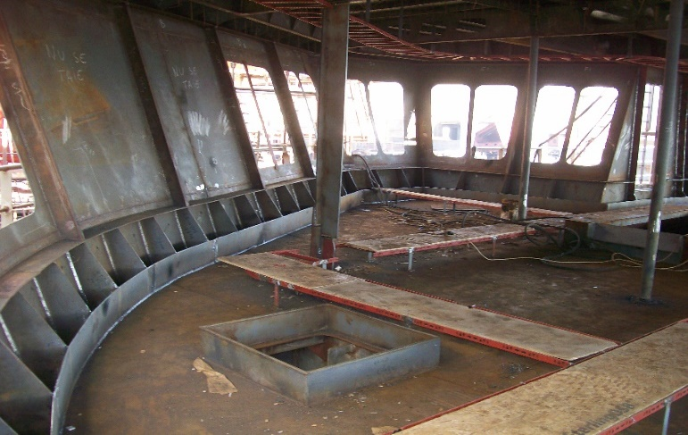
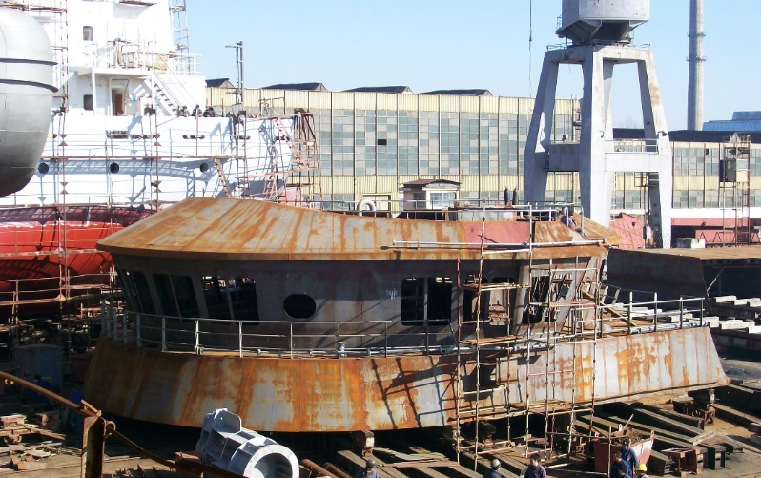

UNIT 1. SHIPBUILDING
CABIN - DESCRIPTION
The cabin is a thin structure of a ship, containing the equipment to conduct the ship. It, generally, has fillet welds on 5-7 mm thickness plates. The most met joints are the welds between the wall and it own stiffeners and the welds between the wall and the decks. They were considered for the analysis.
Weld 1
(Gusset to wall)
Weld 2
(Gusset to deck)
Grade | Chemical composition, %
 | C≤ | Si≤ | Mn | P≤ | S≤ | Cr | Ni | Al
A32 | 0.18 | 0.5 | 0.9- 1.60 | 0.040 | 0.040 | 0.20 | 0.20-0.40 | 0.020- 0.35
STUDY CASE
INDUSTRY

Slide 11
UNIT 1. SHIPBUILDING
GUSSET TO WALL – WPS WELD (stiffening wall by welding gussets)
Welding Procedure Number | 5
Welding Procedure Qualification Record (WPQR) |  | Revision: | 0
Manufacturer: | Shipyard Severnav s.a. | Method Of Preparation and Cleaning: | Cutting in dimension, cleaning impurities and grease, brushing base paint, remove slag after welding, remove spatter after welding
Location: | Workshop, Severnav | Parent Metal Specification: | A32 / A32
Welding Process: | 136 | Parent Metal Thickness | Plates: 7 to 10 mm
Joint Type: | Fillet weld | Welding Position: | PF (vertical up)
Joint Design |  | Welding Sequences
Fig. 1 |  | Fig. 2
10
7
Fig. 1
Run | Process | Size of wire mm | Current A | Voltage V | Type of current/ Polarity | Wire feed speed m/min | Travel speed cm/min | Heat Input J/cm
1 | 136 | 1.2 | 170-180 | 26-27 | DC+ | 8.0-8.5 | 20-21 | 13260
Welding Consumables: Type, Designation Diameter, mm: | ISO 17633-A T 19 12 3 L R C/M 3 AWS A5.22 E316LT0-1/ -4 W.Nr.: 1.4430 1.2 | Technique: Weaving: max 2 mm width at pass 1, max 4 mm width at pass 2 and max 6 mm width at pass 3 Inclination of the wire: 90º, 20º (pull)
Gas / Flux: Gas type Gas Flow Rate | EN ISO 14175: Ar+18%CO₂ 14 - 16 l/min | Post Weld Heat Treatment: -
Details of Back Gouging/Backing:
Fig. 2
STUDY CASE
4

Slide 12
UNIT 1. SHIPBUILDING
GUSSET TO DECK – WPS WELD (stiffening deck by welding gussets)
Welding Procedure Number | 6
Welding Procedure Qualification Record (WPQR) |  | Revision: | 0
Manufacturer: | Shipyard Kladovo | Method Of Preparation and Cleaning: | Cutting in dimension, cleaning impurities and grease, brushing base paint, remove slag after welding, remove spatter after welding; stainless steel tools to be used
Location: | Workshop, Kladovo | Parent Metal Specification: | 316 L / 316 L
Welding Process: | FCAW | Parent Metal Thickness | Plates: 7 to 10 mm
Joint Type: | Fillet Weld | Welding Position: | PA (horizontal)
Joint Design |  | Welding Sequences
Fig. 1 |  | Fig. 2
7
10
Fig. 1
Run | Process | Size of wire mm | Current A | Voltage V | Type of current/ Polarity | Wire feed speed m/min | Travel speed cm/min | Heat Input J/cm
1 | 136 | 1.2 | 180 ± 5 | 26 ± 1 | DC+ | 8.0-8.5 | 18 ± 1 | 15600
Welding Consumables: Type, Designation Diameter, mm: | ISO 17633-A T 19 12 3 L R C/M 3 AWS A5.22 E316LT0-1/ -4 W.Nr.: 1.4430 1.2 | Technique: Weaving: max 2 mm width at pass 1, max 4 mm width at pass 2 and max 6 mm width at pass 3 Inclination of the wire: 90º, 20º (pull)
Gas / Flux: Gas type Gas Flow Rate | EN ISO 14175: Ar+18%CO₂ 14 - 16 l/min | Post Weld Heat Treatment: -
Details of Back Gouging/Backing:
Fig. 2
STUDY CASE
4

Slide 13
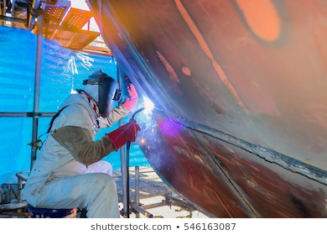
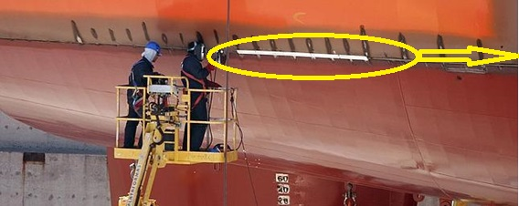
UNIT 1. SHIPBUILDING
WELDING HULL - DESCRIPTION
The hull is welded when build the ship, but any repairing of the hull should be done by welding, as well. The welding is done in manual mode, but mechanized is also possible. The most used processes are GMAW and MMA processes.
Materials: A 131
Grade | Chemical composition, %
 | C≤ | Mn≤ | Si≤ | S≤ | P≤
A131 | 0,21 | 2,50 | 0,50 | 0,035 | 0,035
STUDY CASE
INDUSTRY

Slide 14
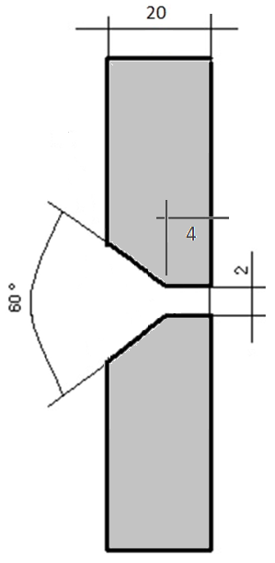
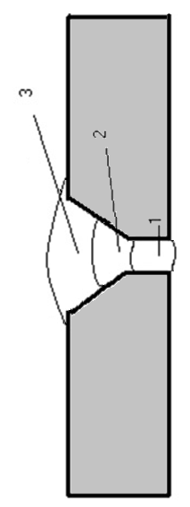
UNIT 1. SHIPBUILDING
WELDING HULL - WPS WELD 1 (interior or exterior board to the bulb stiffeners)
Welding Procedure Number | 7
Welding Procedure Qualification Record (WPQR) |  | Revision: | 0
Manufacturer: | Shipyard Kladovo | Method Of Preparation and Cleaning: | Cutting in dimension, cleaning impurities and grease, brushing base paint, remove slag after welding, remove spatter after welding; stainless steel tools to be used
Location: | Workshop, Kladovo | Parent Metal Specification: | A131
Welding Process: | 136 | Parent Metal Thickness | Plates: 20 to 20 mm
Joint Type: | Butt Weld | Welding Position: | PC (horizontal on vertical wall)
Joint Design |  | Welding Sequences
Fig. 1 |  | Fig. 2
Fig. 1
Run | Process | Size of wire mm | Current A | Voltage V | Type of current/ Polarity | Wire feed speed m/min | Travel speed cm/min | Heat Input J/cm
1 | 136 | 1.2 | 200-210 | 22-23 | DC+ | 8.5-9.0 | 11-12 | 24000
2 | 136 | 1.2 | 200-210 | 22-23 | DC+ | 8.5-9.0 | 11-12 | 24000
3 | 136 | 1.2 | 190-200 | 21-22 | DC+ | 8.5-9.0 | 10-11 | 23700
Welding Consumables: Type, Designation Diameter, mm: | EN 758, T 46 2 P C 1 H5 1.2 | Technique: Weaving: max 2 mm Inclination of the wire: 90º, 20º (pull)
Gas / Flux: Gas type Gas Flow Rate | EN ISO 14175: C1 - 100%CO₂ 14 - 16 l/min | Post Weld Heat Treatment: - Interpass temperature: max 200ºC
Details of Back Gouging/Backing: | NO
Fig. 2
STUDY CASE

Slide 15
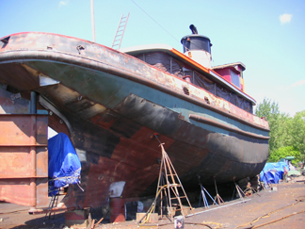
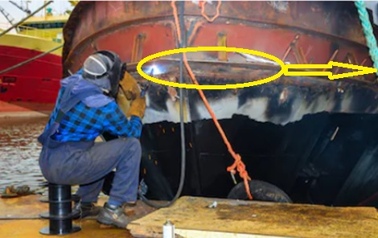
UNIT 1. SHIPBUILDING
WELDING THE BOW OF HULL - DESCRIPTION
The bow assures stability to a ship, and due to that it should welded on the hull. Due to its position, the welding of the bow is done in horizontal and overhead positions. The welding is done in manual mode, but mechanized is also possible. The most used processes are GMAW and MMA processes.
Materials: A 131
Grade | Chemical composition, %
 | C≤ | Mn≤ | Si≤ | S≤ | P≤
A131 | 0,21 | 2,50 | 0,50 | 0,035 | 0,035
STUDY CASE
INDUSTRY

Slide 16
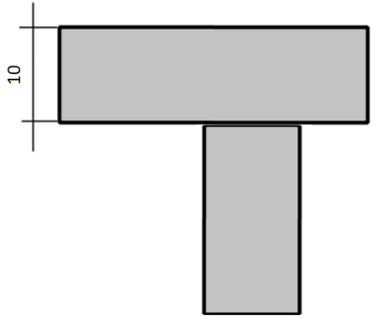
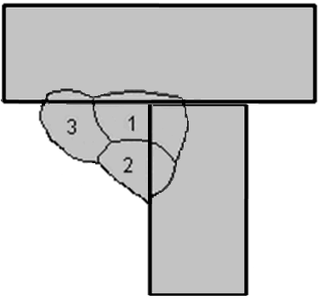
UNIT 1. SHIPBUILDING
WELDING THE BOW OF HULL - WPS WELD (fillet weld of the bow to the hull)
Welding Procedure Number | 8
Welding Procedure Qualification Record (WPQR) |  | Revision: | 0
Manufacturer: | Shipyard Kladovo | Method Of Preparation and Cleaning: | Cutting in dimension, cleaning impurities and grease, brushing base paint, remove slag after welding, remove spatter after welding; stainless steel tools to be used
Location: | Workshop, Kladovo | Parent Metal Specification: | A131
Welding Process: | 136 | Parent Metal Thickness | Plates: 20 to 20 mm
Joint Type: | Butt Weld | Welding Position: | PD (overhead)
Joint Design |  | Welding Sequences
Fig. 1 |  | Fig. 2
Fig. 1
Run | Process | Size of wire mm | Current A | Voltage V | Type of current/ Polarity | Wire feed speed m/min | Travel speed cm/min | Heat Input J/cm
1-3 | 136 | 1.2 | 190 | 21-22 | CC+ | 8,5 | 9.0-9.5 | 11400
Welding Consumables: Type, Designation Diameter, mm: | EN 758, T 46 2 P C 1 H5 1.2 | Technique: Weaving: max 2 mm Inclination of the wire: 90º, 20º (pull)
Gas / Flux: Gas type Gas Flow Rate | EN ISO 14175: C1 - 100%CO₂ 14 - 16 l/min | Post Weld Heat Treatment: - Interpass temperature: max 200ºC
Details of Back Gouging/Backing: | NO
Fig. 2
STUDY CASE

Slide 17
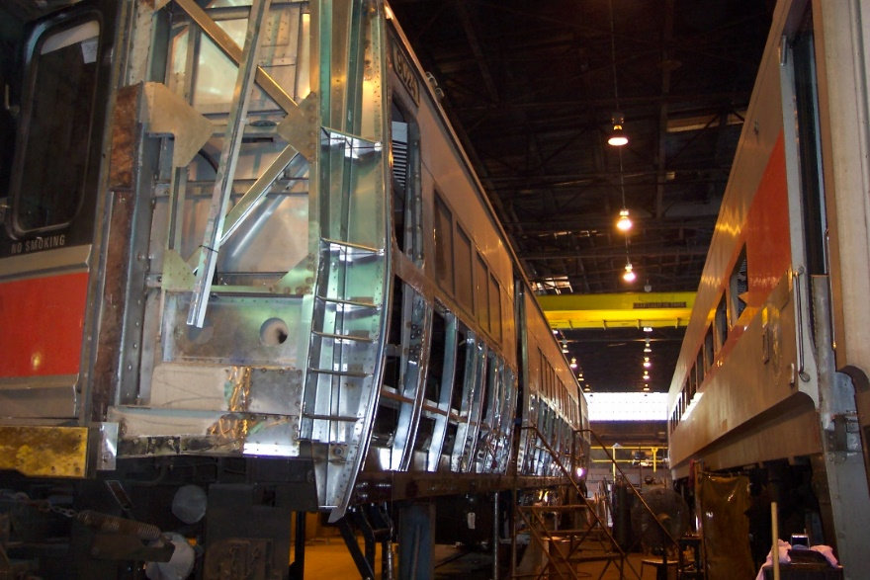
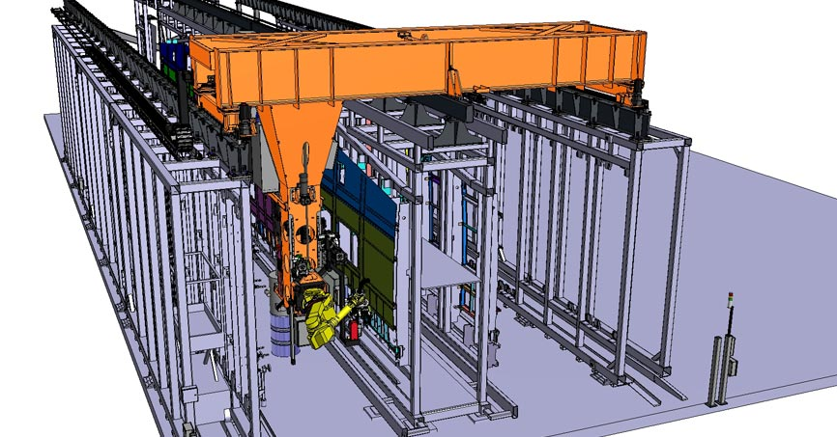
UNIT 2. Railway stock
RAILWAY STOCK
The railcars are welded structures. Hundreds of meters of GMAW welds can be measured on a railcar. TIG and MMA welding processes are, also, applied on a railcar body. The materials used to build a railcar body are the steels, mainly. Low alloy steels having, generally, 360-500 Mpa Yield strength, are used to build the chassis. The rest of the body is produced of lower strength steels or of aluminium alloys (mainly for passenger railcars). If a vessel is mounted on the chassis, the vessel will be build according to the legislation regarding the pressure vessels erection.
The arc welding processes could be applied in robot, automated, mechanized or manual regime.
BACK
STUDY CASE
NEXT
INDUSTRY

Slide 18
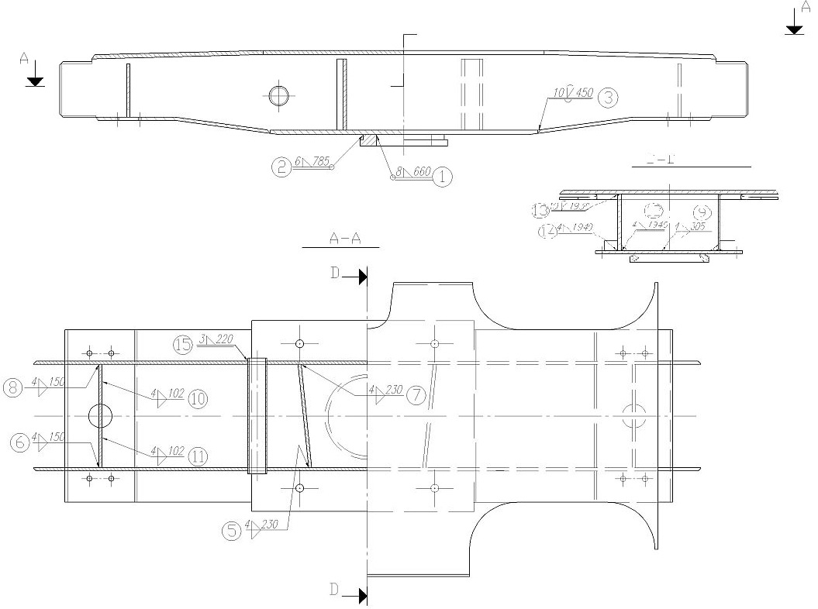
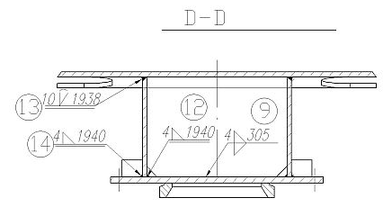
UNIT 2. Railway stock
SIDE LONGERON - DESCRIPTION
The side longeron is one of the two identical components of the chassis which are directly loaded by the freight carriage. It is built as welded structure and is sustained by the two bogies of the car. It is designed to contain steel plates from 8 to 20 mm thickness, depending on the position and functionality of the plate.
According to the figure, all the welds (the lateral sheets with the bottom sheet, the stiffeners with the four sheets) from the section are simple fillet weld, without preparation. The joint between the lateral sheets and the superior sheet is a special fillet weld, having a specific preparation of the groove. That weld it will be considered for the project purposes.
Materials: S355J2-N
Grade | Chemical composition, %
 | C≤ | Si≤ | Mn | P≤ | S≤ | Cu | Ni | Mo | V
S355J2-N | 0,20 | 0,50 | 0,90- 1,55 | 0,035 | 0,030 | 0.35 | 0.50 | 0.10 | 0.12
Weld 13
BACK
STUDY CASE
NEXT
INDUSTRY

Slide 19
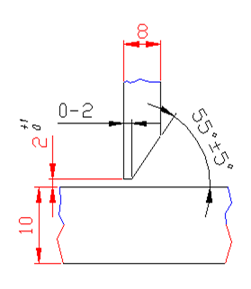
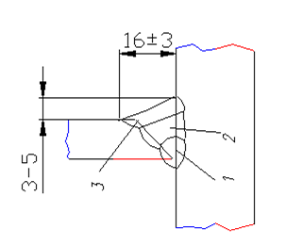
UNIT 2. Railway stock
SIDE LONGERON – WPS WELD 13 (vertical sheets with the superior sheet)
Welding Procedure Number | 9
Welding Procedure Qualification Record (WPQR) |  | Revision: | 0
Manufacturer: | MEVA Drobeta | Method Of Preparation and Cleaning: | Cutting in dimension, cleaning impurities and grease, brushing base paint, remove slag after welding, remove spatter after welding
Location: | Workshop, Drobeta | Parent Metal Specification: | S355J2-N
Welding Process: | 135 | Parent Metal Thickness | Plates: 8 to 10 mm
Joint Type: | Fillet weld | Welding Position: | PA (horizontal)
Joint Design |  | Welding Sequences
Fig. 1 |  | Fig. 2
Run | Process | Size of wire mm | Current A | Voltage V | Type of current/ Polarity | Wire feed speed m/min | Travel speed cm/min | Heat Input J/cm
1 | 135 | 1.2 | 215 ± 5 | 22 ± 1 | DC+ | 6.0 | 20 ± 1 | 14900
2 | 135 | 1.2 | 255 ± 5 | 27 ± 1 | DC+ | 8.0 | 31 ± 1 | 13325
3 | 135 | 1.2 | 255 ± 5 | 27 ± 1 | DC+ | 8.0 | 31 ± 1 | 13325
Fig. 1
Welding Consumables: Type, Designation Diameter, mm: | EN ISO 14341-A:G 3Si1, SFA/AWS A5.18:ER70S-6 1.2 | Technique: Weaving: NO Inclination of the wire: 90º, 20º (pull)
Gas / Flux: Gas type Gas Flow Rate | EN ISO 14175: M21 - 18%CO₂ + rest Ar 12 - 14 l/min | Post Weld Heat Treatment: - Interpass temperature: max 200ºC Stick-out: 15-18 mm
Details of Back Gouging/Backing: | NO
Fig. 2
BACK
STUDY CASE
NEXT
INDUSTRY

Slide 20
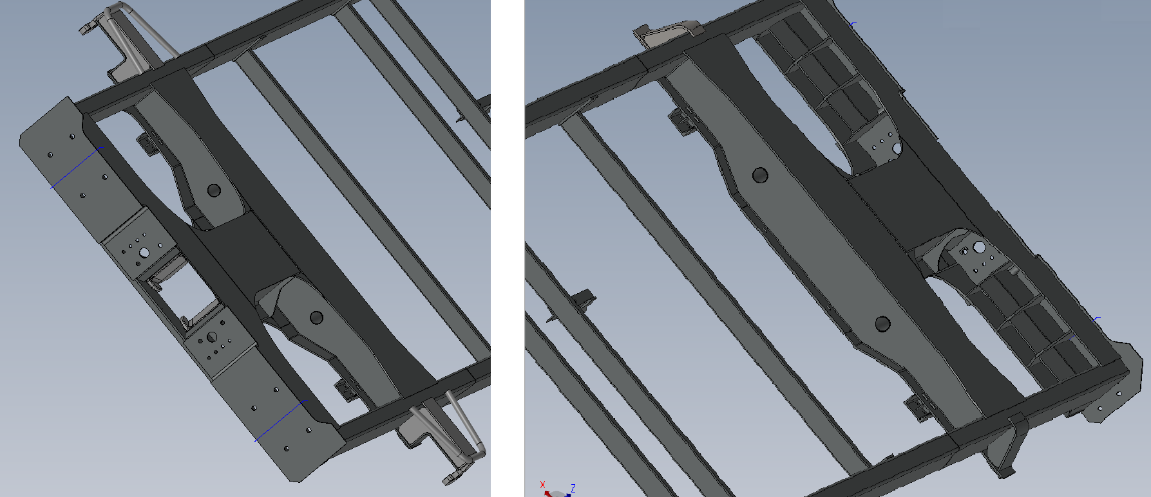
UNIT 2. Railway stock
PIVOT GIRDER - DESCRIPTION
The pivot girder (crossbeam) is a complex and rigid beam supporting at the ends on the side rails and supporting the rotational torque between the chassis and the cargo box. It is a strongly reinforced welded construction to take over the wagon's payloads and the possible unevenness of the railway. It houses the rotating torque that allows the two bogies to change their position relative to each other at the curves.
Most of the welds are fillet welds. The weld considered for the project purposes is a simple fillet weld between the side walls and the superior plate.
Materials: S355J2-N
Weld
Grade | Chemical composition, %
 | C≤ | Si≤ | Mn | P≤ | S≤ | Cu | Ni | Mo | V
S355J2-N | 0,20 | 0,50 | 0,90- 1,55 | 0,035 | 0,030 | 0.35 | 0.50 | 0.10 | 0.12
BACK
STUDY CASE
NEXT
INDUSTRY

Slide 21
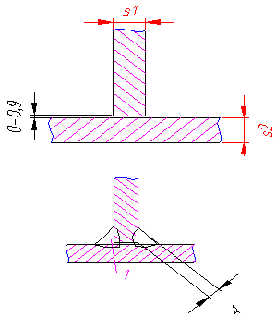
UNIT 2. Railway stock
PIVOT GIRDER – WPS WELD (side wall to superior plate)
Welding Procedure Number | 10
Welding Procedure Qualification Record (WPQR) |  | Revision: | 0
Manufacturer: | MEVA Drobeta | Method Of Preparation and Cleaning: | Cutting in dimension, cleaning impurities and grease, brushing base paint, remove slag after welding, remove spatter after welding
Location: | Workshop, Drobeta | Parent Metal Specification: | S355J2-N
Welding Process: | 135 | Parent Metal Thickness | Plates: 10 to 12 mm
Joint Type: | Fillet weld | Welding Position: | PB (horizontal)
Joint Design |  | Welding Sequences
Fig. 1 |  | Fig. 2
Run | Process | Size of wire mm | Current A | Voltage V | Type of current/ Polarity | Wire feed speed m/min | Travel speed cm/min | Heat Input J/cm
1 | 135 | 1.2 | 255 ± 5 | 27 ± 1 | DC+ | 8.0 | 31 ± 1 | 13325
2 | 135 | 1.2 | 255 ± 5 | 27 ± 1 | DC+ | 8.0 | 31 ± 1 | 13325
Fig. 1
Welding Consumables: Type, Designation Diameter, mm: | EN ISO 14341-A:G 3Si1, SFA/AWS A5.18:ER70S-6 1.2 | Technique: Weaving: NO Inclination of the wire: 90º, 20º (pull)
Gas / Flux: Gas type Gas Flow Rate | EN ISO 14175: M21 - 18%CO₂ + rest Ar 12 - 14 l/min | Post Weld Heat Treatment: - Stick-out: 15-18 mm
Details of Back Gouging/Backing: | NO
Fig. 2
BACK
STUDY CASE
NEXT
INDUSTRY

Slide 22
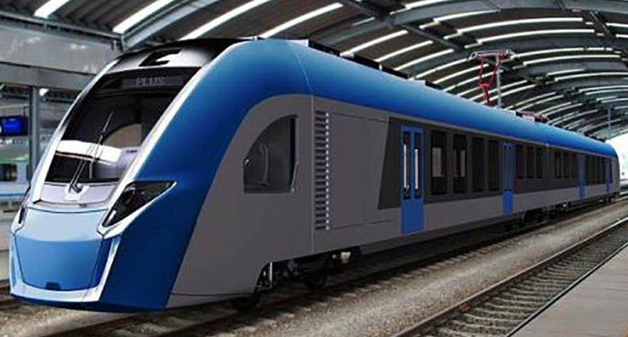
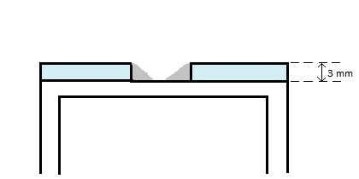
UNIT 2. Railway stock
Weld
RAILCAR BODY STRUCTURE - DESCRIPTION
The exterior plate of a rail car is joined by welding on the resistance structure. Generally, overlapping welds can be meet where to exterior sheets are joined to the same element of structure.
Materials: S355J2-N
Grade | Chemical composition, %
 | C≤ | Si≤ | Mn≤ | P≤ | S≤ | Cu | Ni | Mo | V
S275JR | 0,18 | 0,30 | 1,55 | 0,035 | 0,030 | 0.35 | 0.50 | 0.10 | 0.12
BACK
STUDY CASE
NEXT
INDUSTRY

Slide 23
UNIT 2. Railway stock
RAILCAR BODY STRUCTURE - WPS WELD (outside wall to structure)
Welding Procedure Number | 11
Welding Procedure Qualification Record (WPQR) |  | Revision: | 0
Manufacturer: |  | Method Of Preparation and Cleaning: | Cutting in dimension, cleaning impurities and grease, brushing base paint, remove slag after welding, remove spatter after welding
Location: | Madrid | Parent Metal Specification: | S275JR
Welding Process: | 135 | Parent Metal Thickness | Plates: 3 to 3 mm
Joint Type: | Fillet weld | Welding Position: | PB (horizontal)
Joint Design |  | Welding Sequences
Fig. 1 |  | Fig. 2
10
0-1
Run | Process | Size of wire mm | Current A | Voltage V | Type of current/ Polarity | Wire feed speed m/min | Travel speed cm/min | Heat Input J/cm
1 | 135 | 1.0 | 200-220 | 20-21 | cc+ | 8 | 55-65 | 4200
Fig. 1
Welding Consumables: Type, Designation Diameter, mm: | EN ISO 14341-A:G 3Si1, SFA/AWS A5.18:ER70S-6 1.2 | Technique: Weaving: NO Inclination of the wire: 90º, 20º (pull)
Gas / Flux: Gas type Gas Flow Rate | EN ISO 14175: c1 - 100%CO₂ 12 - 14 l/min | Post Weld Heat Treatment: - Stick-out: 15-18 mm
Details of Back Gouging/Backing: | NO
Fig. 2
BACK
STUDY CASE
NEXT
INDUSTRY

Slide 24
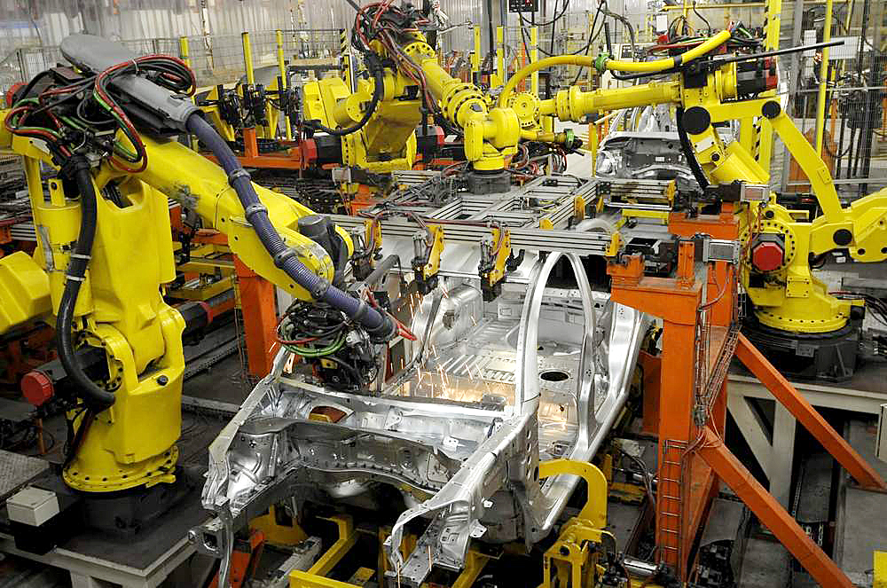
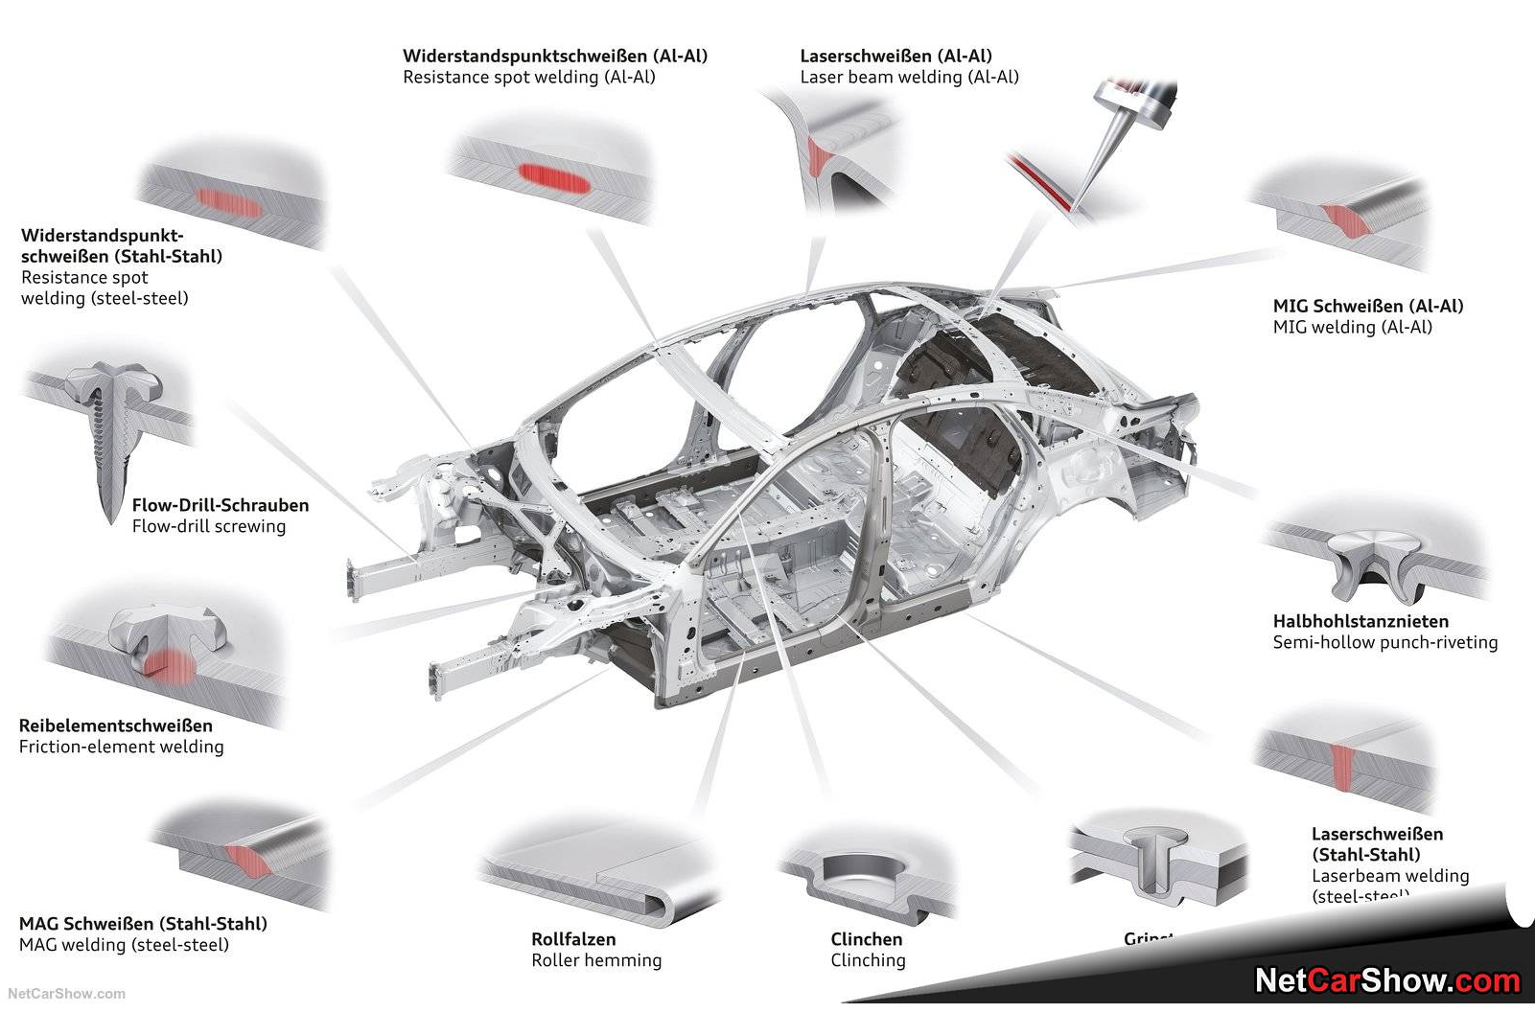
UNIT 2. AUTOMOTIVE
AUTOMOTIVE
Automotive industry is known as high consumer of joining processes, from resistance welding, to arc welding and different bonding processes. Arc welding is limited applied due to the low thickness of all pieces of a car body or the pieces of the chassis. GMA, TIG, MMA and oxy-gas welding processes are involved in the fabrication of the car bodies. The main involved materials are steels and aluminium alloys. The met grades of steels are carbon steels, HSLA, TRIP and TWIP steels. Most of the steel elements are from formed plates. The aluminum alloys could be met in cast or formed pieces.
Regarding the application of the arc welding processes, most of them are done by robot welding. Some small length welds are done manually.
BACK
NEXT

Slide 25
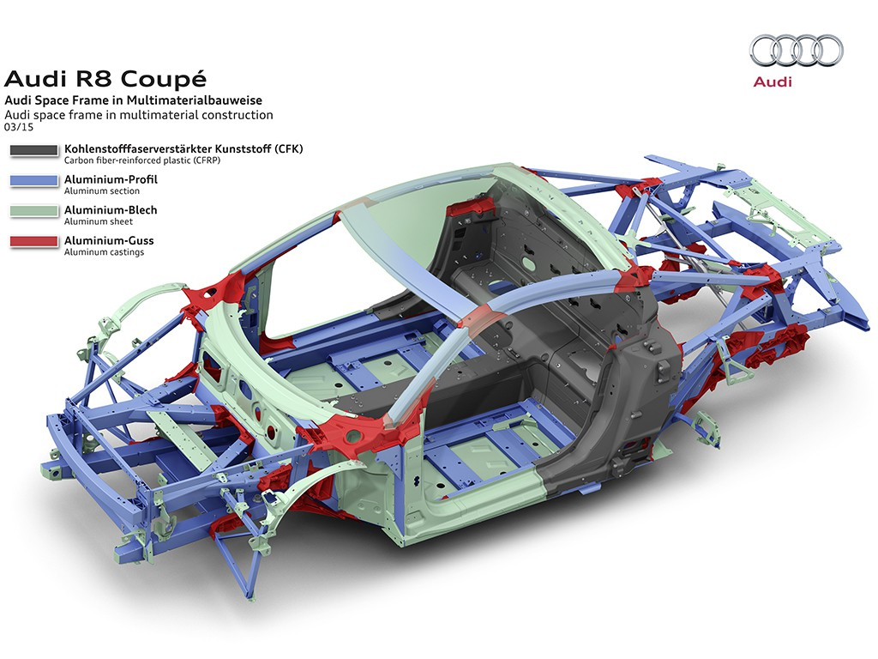
UNIT 3. TITLE
CAR BODY STRUCTURE - DESCRIPTION
A car body has many welds. Most of them are resistance spot welds, but arc welding joints can be meet, as well. Depending on the car, its body can be build by steel or aluminium. The elements of a body are done mainly of formed sheets (up to 3 mm thickness) and by specific laminated profiles. All these elements are joined together by welding and/or by bonding. If the thickness is higher than 1.0 mm, arc welding becomes an option for the joining process.
Materials: AW-5754 / AlMg3
Weld
Grade | Chemical composition, %
 | Mg | Mn+Cr | Mn | Si | Fe | Cr | Zn | Ti | Al
AW-5754 | 2.60-3.60 | 0.10 – 0.60 | 0.00-0.50 | 0.00-0.40 | 0.00-0.40 | 0.00-0.30 | 0.00-0.30 | 0.00-0.15 | rest
BACK
NEXT

Slide 26
UNIT 3. TITLE
CAR BODY STRUCTURE - WPS WELD (profile to create the skelet of the structure)
Welding Procedure Number | 12
Welding Procedure Qualification Record (WPQR) |  | Revision: | 0
Manufacturer: |  | Method Of Preparation and Cleaning: | Cutting in dimension, cleaning impurities and grease, brushing base paint, remove slag after welding, remove spatter after welding
Location: |  | Parent Metal Specification: | AlMg3 / AW 5754 EN 573-1:2008
Welding Process: | 131 | Parent Metal Thickness | Plates: 2 to 2 mm
Joint Type: | Fillet weld (overlapped) | Welding Position: | PB (horizontal)
Joint Design |  | Welding Sequences
Fig. 1 |  | Fig. 2
0
2 2
Fig. 1
Run | Process | Size of wire mm | Current A | Voltage V | Type of current/ Polarity | Wire feed speed m/min | Travel speed cm/min | Heat Input J/cm
1 | 131 | 0.9 | 70-80 | 14-16 | cc+ | 7 | 40-50 | 4200
Welding Consumables: Type, Designation Diameter, mm: | EN – ER 4043 0.9 | Technique: Weaving: NO Inclination of the wire: 90º, 20º (pull)
Gas / Flux: Gas type Gas Flow Rate | EN ISO 14175: I1 - 100%Ar 12 - 14 l/min | Post Weld Heat Treatment: - Stick-out: 12-14 mm
Details of Back Gouging/Backing: | NO
Fig. 2
BACK
NEXT

Slide 27



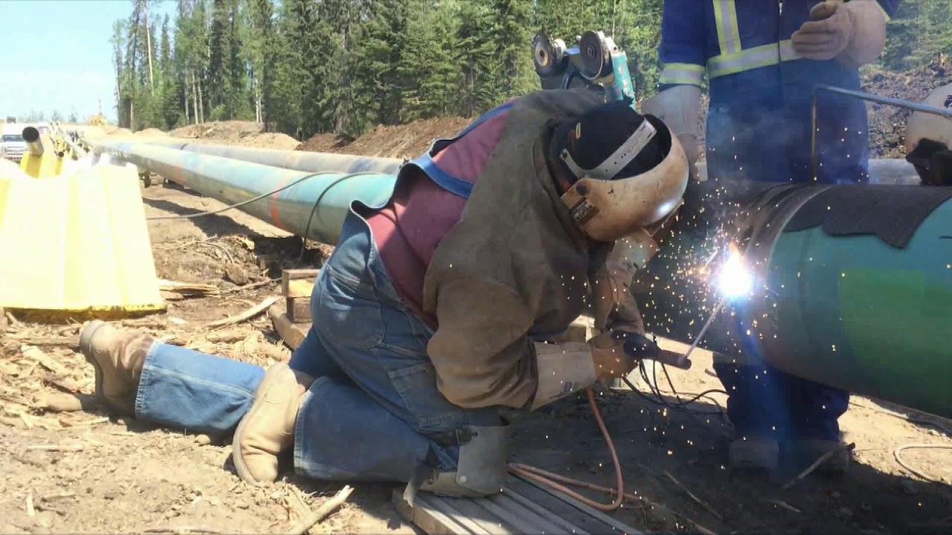
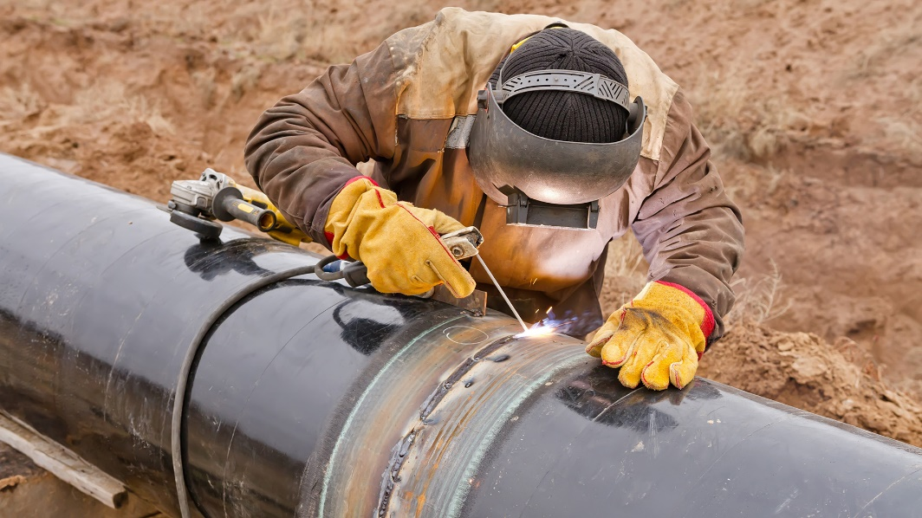
UNIT 5. PIPELINE
Home
Practice
Assessment
PIPELINE
Pipeline is the fifth transportation method and occupies important place in the economy of a country. Each pipeline is done of succession of segments joined together by welding. The main processes used to build a pipeline are the TIG, MMA and GMAW processes. Often mixture of those is used. For instance, the root is prefered to welded by TIG process because TIG is able to create a proper root of the welding. The filling passes are done by GMAW or MMA processes, due to their higher productivity. The welding is done in manual mode, mainly, but mechanized (trucks) and automated processes (orbital) are used for better quality and higher productivity.

Slide 28
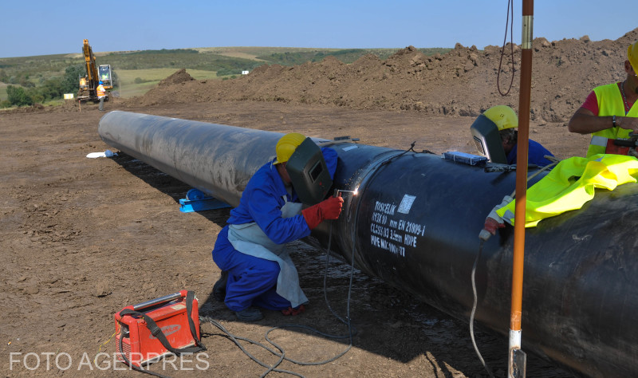
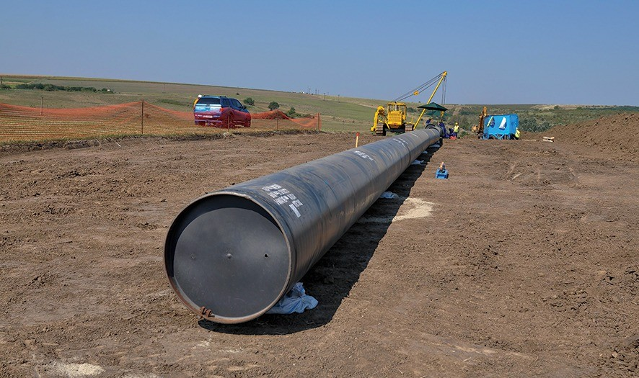
UNIT 5. PIPELINE
Home
Practice
Assessment
BRUA PIPELINE - DESCRIPTION
BRUA pipeline is produced of segments of pipes which are butt welded to create the length necessary to cross Bulgaria, Romania, Hungary and Austria (B.R.U.A.).
The pipe has a diameter of 813 mm, and the thickness of the wall is 10 mm. The welding is done after specific preparation of the groove.
Materials: L415 ME PSL 2, eq. to X60
Grade | Chemical composition, %
 | C≤ | Mn | P≤ | S≤
L415 ME PSL 2 | ≤0.28 | ≤ 1.40 | ≤0.030 | ≤0.030

Slide 29
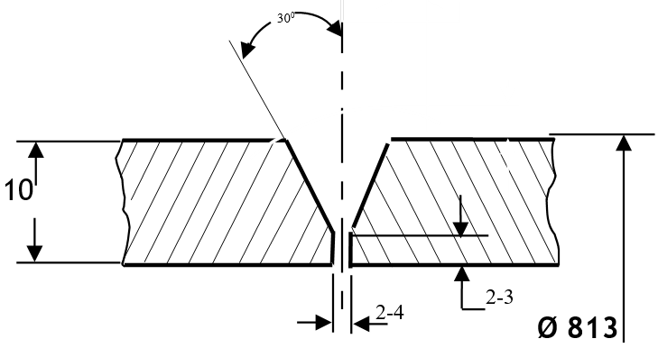
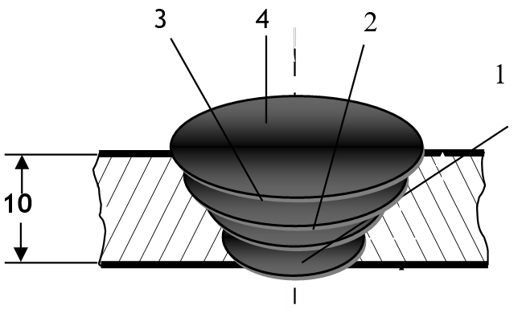
UNIT 5. PIPELINE
Home
Practice
Assessment
BRUA PIPELINE – WPS WELD (butt weld of the pipe segments) version #1
Welding Procedure Number | 13
Welding Procedure Qualification Record (WPQR) |  | Revision: | 0
Manufacturer: | TATI | Method Of Preparation and Cleaning: | Cutting in dimension, cleaning impurities and grease, brushing base paint, remove slag after welding, remove spatter after welding
Location: | Yard, Arad | Parent Metal Specification: | L415 ME PSL 2, ISO 3183/2012
Welding Process: | 141+111 | Parent Metal Thickness | Pipes: 10 to 10 mm
Joint Type: | Butt weld | Welding Position: | PH (vertical up on pipe)
Joint Design |  | Welding Sequences
Fig. 1 |  | Fig. 2
Run | Process | Size of wire mm | Current A | Voltage V | Type of current/ Polarity | Wire feed speed m/min | Travel speed cm/min | Heat Input J/cm
1 | 141 | 3.0 | 120-140 | 20-22 | DC- | - | 15 | 10600
2 | 111 | 3.2 | 100-120 | 18-20 | DC+ | - | 12-14 | 9600
3,4 | 111 | 4.0 | 110-130 | 21-25 | DC+ | - | 13-15 | 12000
Fig. 1
Welding Consumables: Type, Designation Diameter, mm: | Covered electrode: Boehler W 42 5 W3Si1 + E 55 6 1 NiMo B 42 H5 3.0, 3.2, 4.0 Tungsten electrode: WTh2 3.2 | Technique: Weaving: NO Inclination of the wire: 90º, 20º (pull)
Gas / Flux: Gas type Gas Flow Rate | EN ISO 14175: I1 - 100%Ar 10 - 12 l/min | Post Weld Heat Treatment: - Interpass temperature: max 200ºC Dry electrodes: 300ºC / 2h
Details of Back Gouging/Backing: | NO
Fig. 2

Slide 30
UNIT 5. PIPELINE
Home
Practice
Assessment
BRUA PIPELINE – WPS WELD (butt weld of the pipe segments) version #2
Welding Procedure Number | 14
Welding Procedure Qualification Record (WPQR) |  | Revision: | 0
Manufacturer: | HABAU PPS PIPELINE SYSTEMS | Method Of Preparation and Cleaning: | Cutting in dimension, cleaning impurities and grease, brushing base paint, remove slag after welding, remove spatter after welding
Location: | Yard, Arad | Parent Metal Specification: | L415 ME PSL 2, ISO 3183/2012
Welding Process: | 111 | Parent Metal Thickness | Pipes: 10 to 10 mm
Joint Type: | Butt weld | Welding Position: | PH (vertical up on pipe)
Joint Design |  | Welding Sequences
Fig. 1 |  | Fig. 2
Fig. 1
Run | Process | Size of wire mm | Current A | Voltage V | Type of current/ Polarity | Wire feed speed m/min | Travel speed cm/min | Heat Input J/cm
1-2 | 111 | 3.2 | 80-95 | 26-28 | DC+ | -
3-n | 111 | 3.2/4.0 | 110-120/ 140-180 | 27-28/ 28-30 | DC+ | -
Welding Consumables: Type, Designation Diameter, mm: | Covered electrode: Boehler FOX DMO Kb, EN ISO 3580-A : E Mo B 4 2 H5 3.2, 4.0 | Technique: Weaving: max 3 x Ø electrod Inclination of the wire: 90º, 20º (pull)
Gas / Flux: Gas type Gas Flow Rate | EN ISO 14175: I1 - 100%Ar 10 - 12 l/min | Post Weld Heat Treatment: - Interpass temperature: max 200ºC Dry electrodes: 300ºC / 2h
Details of Back Gouging/Backing: | NO
Fig. 2

Slide 31
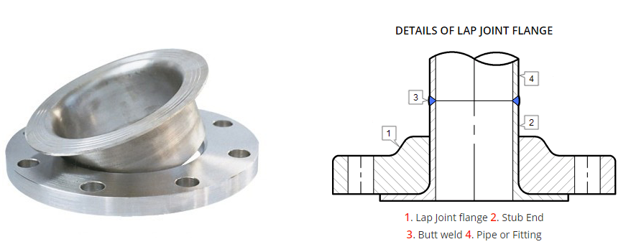
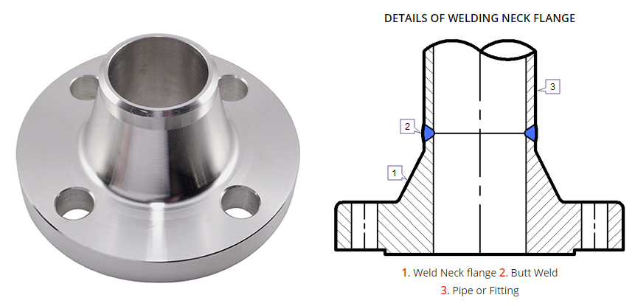
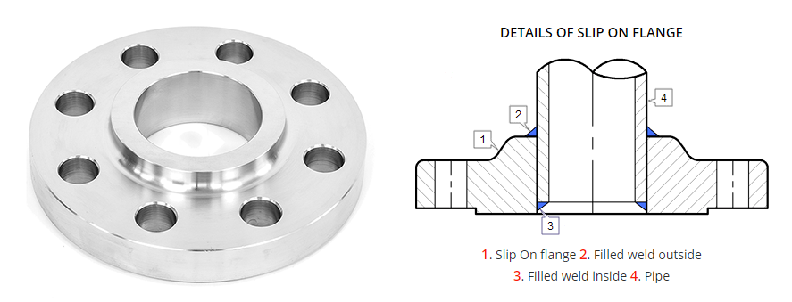
UNIT 5. PIPELINE
Home
Practice
Assessment
WELDING END PIECE WITH FLANGE TO THE PIPE - DESCRIPTION
Sometimes it is necessary to conenct two ends of pipes by using mechanical methods. The most used solution is to use end pieces with flanges which are welded to the ends of the pipes. There are many design solutions for such technology of joining: lap joint flange, neck flange, slip on flange, etc..
Materials: L415 ME PSL 2, eq. to X60
Grade | Chemical composition, %
 | C≤ | Si≤ | Mn | P≤ | S≤ | V+Nb+Ti≤
PSL1, Grade X52 | 0,28 | - | 1,30 | 0,03 | 0,03 | 0,15

Slide 32
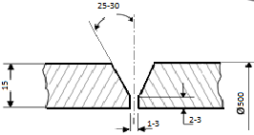

UNIT 5. PIPELINE
Home
Practice
Assessment
WELDING END PIECE WITH FLANGE TO THE PIPE – WPS WELD (butt weld of the pipe to the end piece)
Welding Procedure Number | 15
Welding Procedure Qualification Record (WPQR) |  | Revision: | 0
Manufacturer: |  | Method Of Preparation and Cleaning: | Cutting in dimension, cleaning impurities and grease, brushing base paint, remove slag after welding, remove spatter after welding
Location: | Madrid | Parent Metal Specification: | API 5L - PSL1, Grade X52
Welding Process: | 135 | Parent Metal Thickness | Pipes: 15 to 15 mm, diameter: 500 mm
Joint Type: | Butt weld | Welding Position: | PH (vertical up on pipe)
Joint Design |  | Welding Sequences
Fig. 1 |  | Fig. 2
Run | Process | Size of wire mm | Current A | Voltage V | Type of current/ Polarity | Wire feed speed m/min | Travel speed cm/min | Heat Input J/cm
1 | 135 | 1.2 | 190-200 | 22-23 | CC+ | 6,5 | 20-21 | 11940
2 | 135 | 1.2 | 250-260 | 28-29 | CC+ | 9 | 22-23 | 15000
3,4 | 135 | 1.2 | 250-260 | 28-29 | CC+ | 9 | 20-21 | 20000
Fig. 1
Welding Consumables: Type, Designation Diameter, mm: | EN 14341-A G 42 4 C G4 Si1 3.2 | Technique: Weaving: NO Inclination of the wire: 90º, 20º (pull)
Gas / Flux: Gas type Gas Flow Rate | EN ISO 14175: M21 - 82%Ar+18%Ar 15 - 18 l/min | Post Weld Heat Treatment: - Interpass temperature: max 200ºC
Details of Back Gouging/Backing: | NO
Fig. 2

Slide 33
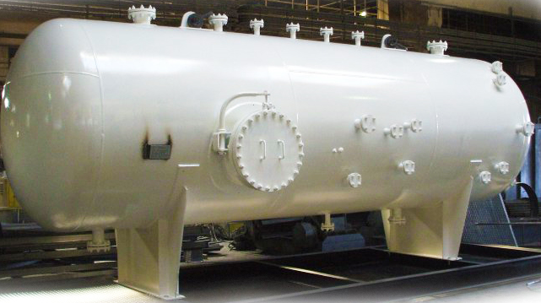
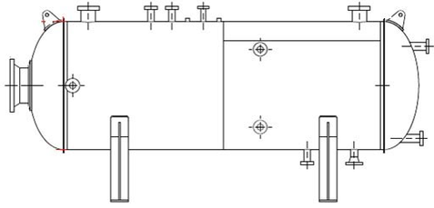
UNIT 6. PRESSURE VESSEL
NOZZLES
SHELL
INLET
HEAD
OUTLET
FIXED SADDLE SUPPORT
SLIDING SADDLE SUPPORT
PRESSURE VESSEL
Pressure vessels are equipment working at high pressures, storing gases. They can have different shapes, but shapes made of sections of spheres, cylinders, and cones are the most used. They are formed of succession of circular shells (cylinders) having the same diameter and welded together until the desired length is obtained. It is closed with two heads of the two ends. A pressure vessel contains, also, nozzles to connect to different equipment or networks, and specific saddles to lean on.
They are made of specific steel, grade P, welded by different processes, according to regulations in force: USA - ASME Boiler and Pressure Vessel Code (BPVC); EU - Pressure Equipment Directive.

Slide 34
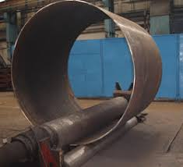
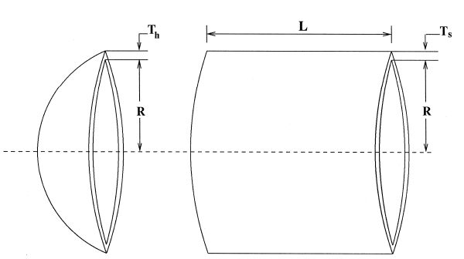
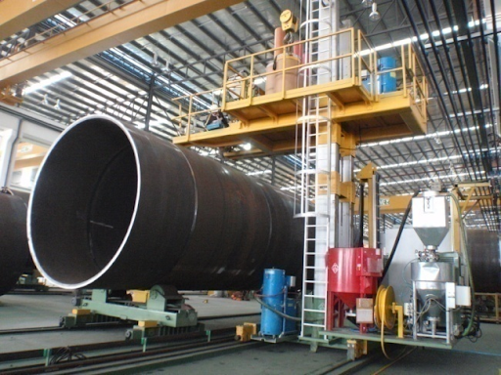
UNIT 6. PRESSURE VESSEL
MEMBRANE WALL (SHELL RING TO SHELL RING AND TWO RINGS WELDED TOGETHER) - DESCRIPTION
The shell is done by rolling a plate with specific thickness to a specific diameter. The ends of the plate are welded together, after preparation of groove. The welding is, generally, done to the interior on the ceramic backing support or flux support, or without support but with root welding from the outside.
Two or more shell rings are welded together, end to end.
The welding to create the shell ring is done in horizontal position.
The welding of two shell rings together are done in vertical up position. Sometimes, the shell rings are rotating and the weld isperformed in horizontal position. The rotation speed is equal to the travel for welding speed.
Both can be manually or mechanized performed.
Materials: P265GH-SR EN 10028-2:2004
Weld
Weld
Grade | Chemical composition, %
 | C≤ | Si≤ | Mn | P≤ | S≤ | Cr | Mo | Ni | Al tot | Cu | Nb
P265GH-SR | ≤0.20 | ≤0.40 | ≤1.40 | 0.025 | 0.020 | ≤0.30 | ≤0.08 | ≤0.30 | ≥0.02 | ≤0.30 | ≤0.01

Slide 35
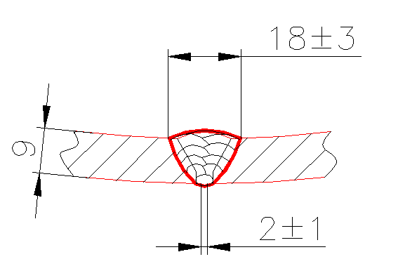
UNIT 6. PRESSURE VESSEL
MEMBRANE WALL (SHELL TO SHELL) - WPS WELD (butt weld of the end of the plate to form shell ring)
Welding Procedure Number | 16
Welding Procedure Qualification Record (WPQR) |  | Revision: | 0
Manufacturer: | - | Method Of Preparation and Cleaning: | Cutting in dimension, cleaning impurities and grease, brushing base paint, remove slag after welding, remove spatter after welding
Location: | Ploiești | Parent Metal Specification: | P265GH
Welding Process: | 136 | Parent Metal Thickness | 12 to 12 mm
Joint Type: | Butt weld | Welding Position: | PA (horizontal)
Joint Design |  | Welding Sequences
Fig. 1 |  | Fig. 2
25±3º
12
2
5-6
Fig. 1
Run | Process | Size of wire mm | Current A | Voltage V | Type of current/ Polarity | Wire feed speed m/min | Travel speed cm/min | Heat Input J/cm
1 | 135 | 1.2 | 220-240 | 25-26 | DC+ | 9-9.5 | 16-17 | 19400
2-5 | 135 | 1.2 | 240-260 | 28-29 | DC+ | 10-10.5 | 18-20 | 21000
root | 135 | 1.2 | 220-240 | 25-26 | DC+ | 9-9.5 | 22-24 | 1500
Welding Consumables: Type, Designation Diameter, mm: | EN 758: T 46 2 P C 1 H AWS A5.20: E71T-1 H4 W.Nr.: 1.4430 1.2 | Technique: Weaving: NO Stick-out: 15-17 mm Inclination of the wire: 90º, 20º (pull)
Gas / Flux: Gas type Gas Flow Rate | EN ISO 14175: 100%CO₂ 12 - 14 l/min | Post Weld Heat Treatment: - Interpass temperature: max 200ºC
Details of Back Gouging/Backing: | Ceramic backing
Fig. 2

Slide 36
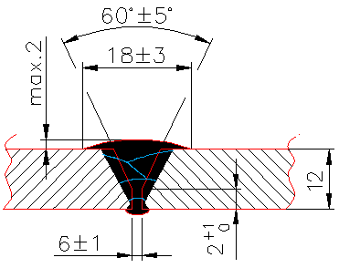
UNIT 6. PRESSURE VESSEL
WELDING TWO SHELL RINGS – WPS WELD (butt weld of the shell rings segments)
Welding Procedure Number | 17
Welding Procedure Qualification Record (WPQR) |  | Revision: | 0
Manufacturer: | - | Method Of Preparation and Cleaning: | Cutting in dimension, cleaning impurities and grease, brushing base paint, remove slag after welding, remove spatter after welding
Location: | Ploiești | Parent Metal Specification: | P265GH
Welding Process: | 136 | Parent Metal Thickness | 12 to 12 mm
Joint Type: | Butt weld | Welding Position: | PH (vertical up)
Joint Design |  | Welding Sequences
Fig. 1 |  | Fig. 2
30±3º
12
2
5-6
Fig. 1
Run | Process | Size of wire mm | Current A | Voltage V | Type of current/ Polarity | Wire feed speed m/min | Travel speed cm/min | Heat Input J/cm
1 | 135 | 1.2 | 220-240 | 25-26 | DC+ | 9-9.5 | 16-17 | 19400
2-5 | 135 | 1.2 | 240-260 | 28-29 | DC+ | 10-10.5 | 18-20 | 21000
Welding Consumables: Type, Designation Diameter, mm: | EN 758: T 46 2 P C 1 H AWS A5.20: E71T-1 H4 W.Nr.: 1.4430 1.2 | Technique: Weaving: NO Stick-out: 15-17 mm Inclination of the wire: 90º, 20º (pull)
Gas / Flux: Gas type Gas Flow Rate | EN ISO 14175: 100%CO₂ 12 - 14 l/min | Post Weld Heat Treatment: - Interpass temperature: max 200ºC
Details of Back Gouging/Backing: | Ceramic backing
Fig. 2

Slide 37



UNIT 6. PRESSURE VESSEL
MOUNTING NOZZLES (NOZZLE TO SHELL RING WELDING) - DESCRIPTION
The nozzles are elements to allow the visit of the inside or to introduce or exit gases and/or liquids. They are pipes, generally with flanges, built of the same material as the vessel, and which are welded to the shell ring of the vessel.
The weld is a fillet weld done in the exterior of the shell ring. Id the pressure inside the vessel is very high, it could be recommended to have welds at the inside, as well.
Materials: P265GH-SR EN 10028-2:2004
Grade | Chemical composition, %
 | C≤ | Si≤ | Mn | P≤ | S≤ | Cr | Mo | Ni | Al tot | Cu | Nb
P265GH-SR | ≤0.20 | ≤0.40 | ≤1.40 | 0.025 | 0.020 | ≤0.30 | ≤0.08 | ≤0.30 | ≥0.02 | ≤0.30 | ≤0.01
SHELL RING
NOZZLE WALL

Slide 38
UNIT 6. PRESSURE VESSEL
WELDING NOZZLE TO SHELL RINGS – WPS WELD (fillet weld of the nozzle wall and the shell rings)
Welding Procedure Number | 18
Welding Procedure Qualification Record (WPQR) |  | Revision: | 0
Manufacturer: | - | Method Of Preparation and Cleaning: | Cutting in dimension, cleaning impurities and grease, brushing base paint, remove slag after welding, remove spatter after welding
Location: | Ploiești | Parent Metal Specification: | P265GH
Welding Process: | 136 | Parent Metal Thickness | 6 to 12 mm
Joint Type: | Fillet weld | Welding Position: | PA (horizontal)
Joint Design |  | Welding Sequences
Fig. 1 |  | Fig. 2
35-40º
2
1
Fig. 1
Run | Process | Size of wire mm | Current A | Voltage V | Type of current/ Polarity | Wire feed speed m/min | Travel speed cm/min | Heat Input J/cm
1 | 141 | 3.0 | 130-140 | 20-21 | DC- | - | 14 | 12150
2-4 | 135 | 1.2 | 240-260 | 28-29 | DC+ | 10-10.5 | 18-20 | 21000
root | 135 | 1.2 | 220-240 | 25-26 | DC+ | 9-9.5 | 22-24 | 1500
Welding Consumables: Type, Designation Diameter, mm: | 141: Tungsten electrode: WTh2 3.2 136: EN 758: T 46 2 P C 1 H AWS A5.20: E71T-1 H4 W.Nr.: 1.4430 1.2 | Technique: Weaving: max 3 mm Stick-out: 15-17 mm Inclination of the wire: 90º, 20º (pull)
Gas / Flux: Gas type Gas Flow Rate | 141: EN ISO 14175: C1 - 100%CO₂ 12 - 14 l/min 136: EN ISO 14175: C1 - 100%CO₂ 12 - 14 l/min | Post Weld Heat Treatment: - Interpass temperature: max 200ºC
Details of Back Gouging/Backing: | NO
Fig. 2

Slide 39



UNIT 6. PRESSURE VESSEL
MEMBRANE WALL - DESCRIPTION
The membrane walls are used in boilers to make heat exchangers. It is about huge networks of welded pipes for forming a wall. There are sheets of sheet between the pipes. The pipes are welded by these sheets of sheet metal.
Materials: P265GH-SR EN 10028-2:2004
Grade | Chemical composition, %
 | C≤ | Si≤ | Mn | P≤ | S≤ | N≤ | Cu≤
Pipes: SA210GrA1 | 0,27 | 0,10 | 0,93 | 0,048 | 0,058
Plates: S275JR | 0,21 | - | 1,5 | 0,035 | 0,035 | 0,012 | 0,40

Slide 40
UNIT 6. PRESSURE VESSEL
MEMBRANE WALL - WPS WELD (fillet weld of the wall to the pipes)
Welding Procedure Number | 19
Welding Procedure Qualification Record (WPQR) |  | Revision: | 0
Manufacturer: | - | Method Of Preparation and Cleaning: | Cutting in dimension, cleaning impurities and grease, brushing base paint, remove slag after welding, remove spatter after welding
Location: | Ploiești | Parent Metal Specification: | Pipes (Ø50x5 mm): SA210GrA1 Plates (6 mm): S275JR
Welding Process: | 136 | Parent Metal Thickness | 6 to 5 mm
Joint Type: | Fillet weld | Welding Position: | PA (horizontal)
Joint Design |  | Welding Sequences
Fig. 1 |  | Fig. 2
0-2
40-50º
2
6
Fig. 1
Run | Process | Size of wire mm | Current A | Voltage V | Type of current/ Polarity | Wire feed speed m/min | Travel speed cm/min | Heat Input J/cm
1 | 135 | 1.0 | 200-210 | 25-26 | DC+ | 9.0-9.5 | 60 | 5000
2 | 135 | 1.0 | 240-260 | 26-28 | DC+ | 9.0-9.5 | 60 | 6250
Welding Consumables: Type, Designation Diameter, mm: | EN ISO 14341-A:G 3Si1, SFA/AWS A5.18:ER70S-6 1.2 | Technique: Weaving: max 3 mm to pass 2 Stick-out: 15-17 mm Inclination of the wire: 90º, 20º (pull)
Gas / Flux: Gas type Gas Flow Rate | EN ISO 14175: M21 - 18%CO₂ + rest Ar 12 - 14 l/min | Post Weld Heat Treatment: - Interpass temperature: max 200ºC
Details of Back Gouging/Backing: | NO
Fig. 2

Slide 41



UNIT 7. CIVIL CONSTRUCTION
CIVIL CONSTRUCTION
Civil constructions refer, generally, to structures dedicated to civil purposes, as residential buildings, fair halls, industrial halls, bridges, gyms, towers, crosswalks for hard traffic roads and else. They replace the concrete structure of construction with metal structure; some of their elements are fastened using screws, but most of the components are connected by welding. The welding creates forms, by putting in specific position the components. Due to that, the most welds are fillet welds.
Such structure is formed of beams, girders and other types of elements which are fixed each other by specific nodes. The nods are based on gussets having appropriate shape and dimensions. The elements ends are not directly welded each other, but each element is welded with the gusset. Gussets are used for the stiffening of different intersections of elements which are or not welded together.

Slide 42
UNIT 7. CIVIL CONSTRUCTION
Some elements of a civil constructions are designed as multiple beams fixed together in parallel position in order to create stiff horizontal or vertical wall. In such cases the welding is done between each beam and the stiffener. The weld can join together in direct manner or gusset, as intermediary element, is needed. Such combination creates a double node, which is a resistance node and the three elements (or five if gussets are required) can be different types of laminated profiles. The connecting element could be an U profile, or a T profile or rectangular pipe, or else.
Material: S235, S355
STIFFENING TWO PARALEL GIRDERS - DESCRIPTION
Grade | Chemical composition, %
 | C≤ | Si≤ | Mn | P≤ | S≤ | Cu | Ni | Mo | V | Nb | Cr
S355J2 | 0,20 | 0,50 | 0,90- 1,55 | 0,035 | 0,030 | 0.35 | 0.50 | 0.10 | 0.12 | 0.05 | 0.03

Slide 43
UNIT 7. CIVIL CONSTRUCTION
STIFFENING TWO PARALEL GIRDERS – WPS WELD (fillet weld of the transverse element with the girders)
Welding Procedure Number | 20
Welding Procedure Qualification Record (WPQR) |  | Revision: | 0
Manufacturer: | ALPHA CONSTRUCT | Method Of Preparation and Cleaning: | Cutting in dimension, cleaning impurities and grease, brushing base paint, remove slag after welding, remove spatter after welding
Location: | Drobeta | Parent Metal Specification: | S355
Welding Process: | 135 | Parent Metal Thickness | Laminated profiles – U on L: 6 to 8 mm
Joint Type: | Fillet weld | Welding Position: | PF (vertical up)
Joint Design |  | Welding Sequences
Fig. 1 |  | Fig. 2
Fig. 1
Run | Process | Size of wire mm | Current A | Voltage V | Type of current/ Polarity | Wire feed speed m/min | Travel speed cm/min | Heat Input J/cm
1,2 | 135 | 1.2 | 190-200 | 21-22 | DC+ | 7 | 35 | 7200
Welding Consumables: Type, Designation Diameter, mm: | EN ISO 14341-A:G 3Si1, SFA/AWS A5.18:ER70S-6 1.2 | Technique: Weaving: NO Stick-out: 15-17 mm Inclination of the wire: 90º, 20º (pull)
Gas / Flux: Gas type Gas Flow Rate | EN ISO 14175: M21 - 18%CO₂ + rest Ar 12 - 14 l/min | Post Weld Heat Treatment: -
Details of Back Gouging/Backing: | NO
Fig. 2

Slide 44


UNIT 7. CIVIL CONSTRUCTION
Some elements of a civil constructions are designed to cross each other, and the joint to require extra stiffening. In such cases the welding is done between each element and the stiffening gusset. All three elements are made of metal sheets and the gusset has specific form to allow the welding of the two elements each other and to reduce the concentration of stresses in the node.
Material: S235, S355
STIFFENING TWO ELEMENTS CROSSING BY GUSSET - DESCRIPTION
Industrial building frame
Industrial building cabin
Grade | Chemical composition, %
 | C≤ | Si≤ | Mn | P≤ | S≤ | Cu | Ni | Mo | V | Nb | Cr
S355J2 | 0,20 | 0,50 | 0,90- 1,55 | 0,035 | 0,030 | 0.35 | 0.50 | 0.10 | 0.12 | 0.05 | 0.03
allows the welding of the two elements each other
reduces the concentration of stresses

Slide 45
UNIT 7. CIVIL CONSTRUCTION
STIFFENING TWO ELEMENTS CROSSING BY GUSSET – WPS WELD (fillet welds of the gusset and the plates)
Welding Procedure Number | 21
Welding Procedure Qualification Record (WPQR) |  | Revision: | 0
Manufacturer: | ALPHA CONSTRUCT | Method Of Preparation and Cleaning: | Cutting in dimension, cleaning impurities and grease, brushing base paint, remove slag after welding, remove spatter after welding
Location: | Drobeta | Parent Metal Specification: | S355
Welding Process: | 135 | Parent Metal Thickness | Plates: 7 to 10 mm
Joint Type: | Fillet weld | Welding Position: | PE (overhead) and PF (vertical up)
Joint Design |  | Welding Sequences
Fig. 1 |  | Fig. 2
Fig. 1
Run | Process | Size of wire mm | Current A | Voltage V | Type of current/ Polarity | Wire feed speed m/min | Travel speed cm/min | Heat Input J/cm
PE | 135 | 1.2 | 220-230 | 22-23 | DC+ | 9 | 35 | 8700
PF | 135 | 1.2 | 210-220 | 22-23 | DC+ | 9 | 20 | 13860
Welding Consumables: Type, Designation Diameter, mm: | EN ISO 14341-A:G 3Si1, SFA/AWS A5.18:ER70S-6 1.2 | Technique: Weaving: NO Stick-out: 15-17 mm Inclination of the wire: 90º, 20º (pull)
Gas / Flux: Gas type Gas Flow Rate | EN ISO 14175: M21 - 18%CO₂ + rest Ar 12 - 14 l/min | Post Weld Heat Treatment: -
Details of Back Gouging/Backing: | NO
Fig. 2

Slide 46

UNIT 7. CIVIL CONSTRUCTION
In some nodes beams are welded together even if their dimensions differ very much. Such nodes are classic structural nodes. The largest beam is cut to allow the passage of the smallest beam, after which the two are welded to each other, through fillet weld.
Material: S235, S355
INTERSECTION OF I BEAMS - DESCRIPTION
Grade | Chemical composition, %
 | C≤ | Mn≤ | Si≤ | S≤ | P≤
S235J2 | 0.17 | 1.40 | - | 0.040 | 0.040
4

Slide 47
UNIT 7. CIVIL CONSTRUCTION
INTERSECTION OF I BEAMS – WPS WELD (fillet weld)
Welding Procedure Number | 22
Welding Procedure Qualification Record (WPQR) |  | Revision: | 0
Manufacturer: |  | Method Of Preparation and Cleaning: | Cutting in dimension, cleaning impurities and grease, brushing base paint, remove slag after welding, remove spatter after welding
Location: | Madrid | Parent Metal Specification: | S235
Welding Process: | 135 | Parent Metal Thickness | Plates: 8 to 10 mm
Joint Type: | Fillet weld | Welding Position: | PF (vertical up)
Joint Design |  | Welding Sequences
Fig. 1 |  | Fig. 2
⁸
⁰⁻¹
¹⁰
Fig. 1
Run | Process | Size of wire mm | Current A | Voltage V | Type of current/ Polarity | Wire feed speed m/min | Travel speed cm/min | Heat Input J/cm
1,2 | 135 | 1.2 | 160-180 | 22-23 | DC+ | 8 | 15-16 | 14000
Welding Consumables: Type, Designation Diameter, mm: | EN ISO 14341-A:G 3Si1, SFA/AWS A5.18:ER70S-6 1.2 | Technique: Weaving: NO Stick-out: 15-17 mm Inclination of the wire: 90º, 20º (pull)
Gas / Flux: Gas type Gas Flow Rate | EN ISO 14175: C1 - 100%CO₂ 12 - 14 l/min | Post Weld Heat Treatment: -
Details of Back Gouging/Backing: | NO
Fig. 2

Slide 48


UNIT 7. CIVIL CONSTRUCTION
Two or more beams could met in a node by using gussets as support. The beams are not weled each other, but each is welded to the gusset. So, in a node there are several shorts fillet weld, actually overlapping joints.
Material: S235, S355
NODE OF TWO ELEMENTS OF A BRIDGE - DESCRIPTION
Grade | Chemical composition, %
 | C≤ | Mn≤ | Si≤ | S≤ | P≤
S235J2 | 0.17 | 1.40 | - | 0.040 | 0.040

Slide 49
UNIT 7. CIVIL CONSTRUCTION
NODE OF TWO ELEMENTS OF A BRIDGE – WPS WELD (fillet / overlapped weld)
Welding Procedure Number | 23
Welding Procedure Qualification Record (WPQR) |  | Revision: | 0
Manufacturer: |  | Method Of Preparation and Cleaning: | Cutting in dimension, cleaning impurities and grease, brushing base paint, remove slag after welding, remove spatter after welding
Location: | Madrid | Parent Metal Specification: | S235
Welding Process: | 135 | Parent Metal Thickness | Plates: 8 to 10 mm
Joint Type: | Fillet weld | Welding Position: | PF (vertical up)
Joint Design |  | Welding Sequences
Fig. 1 |  | Fig. 2
3.5
¹⁰ ⁸
⁰⁻¹
Fig. 1
Run | Process | Size of wire mm | Current A | Voltage V | Type of current/ Polarity | Wire feed speed m/min | Travel speed cm/min | Heat Input J/cm
1,2 | 135 | 1.2 | 200-220 | 24-25 | DC+ | 9 | 16-17 | 17800
Welding Consumables: Type, Designation Diameter, mm: | EN ISO 14341-A:G 3Si1, SFA/AWS A5.18:ER70S-6 1.2 | Technique: Weaving: NO Stick-out: 15-17 mm Inclination of the wire: 90º, 20º (pull)
Gas / Flux: Gas type Gas Flow Rate | EN ISO 14175: M21 – 82%Ar+18%CO₂ 12 - 14 l/min | Post Weld Heat Treatment: -
Details of Back Gouging/Backing: | NO
Fig. 2

Slide 50

UNIT 7. CIVIL CONSTRUCTION
The structural beams nodes are vital in structures. They create the network which assures the resistance and the mechanical behaviour of the structure. In a node can meet two or more ends of beams, welded directly each other or using linking elements.
Material: S235, S355
STRUCTURAL BEAMS NODE - DESCRIPTION
Grade | Chemical composition, %
 | C≤ | Mn≤ | Si≤ | S≤ | P≤
S275JR | S275 JR | 0,18 | 1,5 | 0,03 | 0,035

Slide 51
UNIT 7. CIVIL CONSTRUCTION
STRUCTURAL BEAMS NODE – WPS WELD (fillet weld)
Welding Procedure Number | 24
Welding Procedure Qualification Record (WPQR) |  | Revision: | 0
Manufacturer: |  | Method Of Preparation and Cleaning: | Cutting in dimension, cleaning impurities and grease, brushing base paint, remove slag after welding, remove spatter after welding
Location: | Madrid | Parent Metal Specification: | S275
Welding Process: | 111 | Parent Metal Thickness | Plates: 8 to 10 mm
Joint Type: | Fillet weld | Welding Position: | PF (vertical up)
Joint Design |  | Welding Sequences
Fig. 1 |  | Fig. 2
¹⁰
⁰⁻¹
¹⁰
Fig. 1
Run | Process | Size of wire mm | Current A | Voltage V | Type of current/ Polarity | Wire feed speed m/min | Travel speed cm/min | Heat Input J/cm
1 | 111 | 3,25 | 125 | 20 | DC+ | - | 15 | 10000
2 | 111 | 3,25 | 100 | 19 | DC+ | - | 14 | 8142
Welding Consumables: Type, Designation Diameter, mm: V | EN ISO 2560-A, E 38 A R 11 1.2 | Technique: Weaving: max 3 mm Inclination of the wire: 90º, 20º (pull)
Gas / Flux: Gas type Gas Flow Rate | - | Post Weld Heat Treatment: -
Details of Back Gouging/Backing: | NO
Fig. 2

Slide 52




UNIT 7. CIVIL CONSTRUCTION
Structural tubes are often met in the structure of a building having large openings (fair halls, gyms, etc.). The tubes are joined together in specific nodes: all ends welded together, or all ends meet in a gusset, or all ends enters a specific fixing device and the joining in such device is done with mechanical elements.
When weld the ends directly, the structure is easier than using gussets.
Material: S275 JR
STRUCTURAL TUBES NODE - DESCRIPTION
Grade | Chemical composition, %
 | C≤ | Mn≤ | Si≤ | S≤ | P≤
S275JR | S275 JR | 0,18 | 1,5 | 0,03 | 0,035

Slide 53
UNIT 7. CIVIL CONSTRUCTION
STRUCTURAL TUBES NODE – WPS WELD (fillet weld)
Welding Procedure Number | 25
Welding Procedure Qualification Record (WPQR) |  | Revision: | 0
Manufacturer: |  | Method Of Preparation and Cleaning: | Cutting in dimension, cleaning impurities and grease, brushing base paint, remove slag after welding, remove spatter after welding
Location: | Madrid | Parent Metal Specification: | S275
Welding Process: | 135 | Parent Metal Thickness | Tubes: 6 to 6 mm, diameters: 100 mm
Joint Type: | Fillet weld | Welding Position: | PA (horizontal)
Joint Design |  | Welding Sequences
Fig. 1 |  | Fig. 2
⁶
⁰⁻¹
⁶
Fig. 1
Run | Process | Size of wire mm | Current A | Voltage V | Type of current/ Polarity | Wire feed speed m/min | Travel speed cm/min | Heat Input J/cm
1 | 135 | 1.2 | 130-150 | 21-22 | DC+ | 6,5 | 14-15 | 11760
Welding Consumables: Type, Designation Diameter, mm: V | EN ISO 14341-A:G 3Si1, SFA/AWS A5.18:ER70S-6 1.2 | Technique: Weaving: max 3 mm Inclination of the wire: 90º, 20º (pull)
Gas / Flux: Gas type Gas Flow Rate | EN ISO 14175: M21 - 18%CO₂ + rest Ar 12 - 14 l/min | Post Weld Heat Treatment: -
Details of Back Gouging/Backing: | NO
Fig. 2

Slide 54
RESOURCES & REFERENCES
RESOURCES
Icons made by Freepik from www.flaticon.com. Creative Commons BY 3.0

